Slide 1
Categorizing YouTube Videos
Nitesh Gupta
Tanmay Gore

Slide 2
Why Categorize Youtube Videos?
Benefits :
Monetary Benefits
Video Recommendation
How to categorize :
Can consider metadata for classification

Slide 3
TFIDF
Data Set contains following features:
Title
Tags
Description
Converts text to numbers
Prioritizes meaningful information over stop words
Result – 50,000 dimensions

Slide 4
TFIDF
TF - Term frequency
Number Of Times A Word Occurs In A Document
Tf(t) = (Number Of Times Term T Appears In A Document) / (Total Number Of Terms In The Document).
IDF - Inverse Document Frequency
Measure Of How Important The Term Is In A Document
Idf(t) = Log_e(Total Number Of Documents / Number Of Documents With Term T)

Slide 5
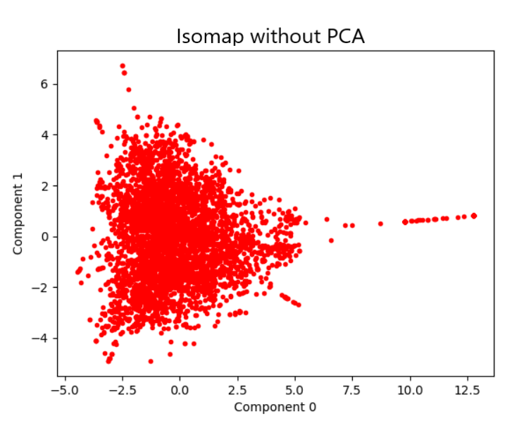
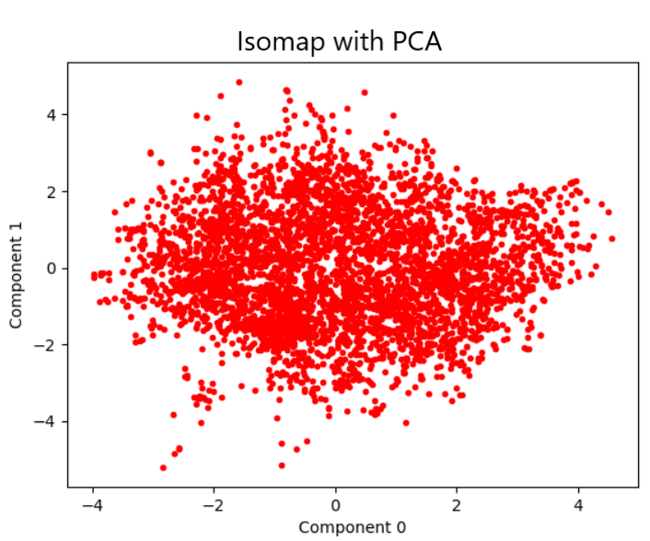
PCA
Dimensionality Reduction
Reduces 50, 000 dimensions to 3000 with only 5% loss of information.

Slide 6
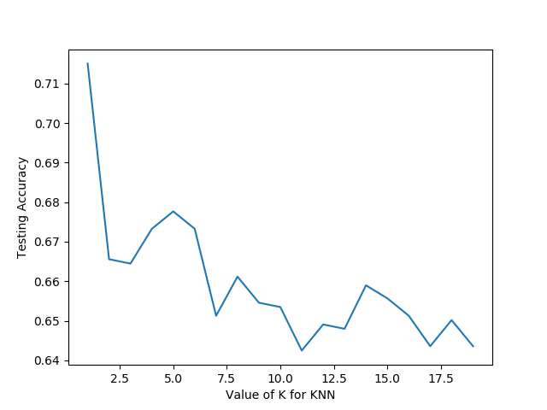
K Nearest neighbor
K-Nearest Neighbors
K | 5
Features Used | Tags, Title, Description, Tag Count
Accuracy | 67.7 percent
Training Time | 143 seconds

Slide 7
K Nearest neighbor
CLASS CONDITIONAL ACCURACY
CONFUSION MATRIX
Class 0 : 0.3409
Class 1 : 0.4167
Class 2 : 0.8108
Class 3 : 0.0
Class 4 : 0.75
Class 5 : 0.7538
Class 6 : 0.3333
Class 7 : 0.3636
Class 8 : 0.4407
Class 9 : 0.7529
Class 10 : 0.694
Class 11 : 0.8085
Class 12 : 0.6538
Class 13 : 0.5714
Class 14 : 0.6545
Class 15 : 0.0
[15 0 4 0 0 1 1 0 2 3 16 0 1 0 1 0]
[ 0 5 0 0 0 0 0 0 0 0 4 2 0 0 1 0]
[ 1 0 90 0 1 0 0 0 3 2 10 2 1 0 1 0]
[ 0 0 0 0 0 0 0 0 0 0 0 0 0 0 1 0]
[ 0 1 1 0 15 0 0 0 2 0 1 0 0 0 0 0]
[ 3 0 1 0 1 49 0 0 3 0 4 4 0 0 0 0]
[ 0 1 0 0 1 0 4 0 1 0 2 2 1 0 0 0]
[ 0 0 1 0 1 1 0 4 0 0 3 0 0 0 1 0]
[ 1 1 9 0 1 1 0 1 26 2 9 3 2 1 2 0]
[ 0 0 1 0 1 2 0 0 2 64 13 1 1 0 0 0]
[ 5 0 14 0 2 4 3 3 12 10 161 7 9 0 2 0]
[ 0 0 2 0 1 4 0 0 3 1 3 76 0 1 3 0]
[ 1 0 2 0 0 2 0 0 9 0 11 1 51 0 1 0]
[ 0 0 0 0 1 0 0 0 2 1 2 1 5 16 0 0]
[ 1 0 2 0 1 0 0 0 6 0 2 1 4 2 36 0]
[ 0 0 0 0 0 0 0 0 0 0 1 0 1 0 0 0]

Slide 8
Neural networks
Best Hyper Parameter Values
Error Function | categorical_crossentropy
Hidden Units | linear
Number of Hidden Layers | 3
Number of Neurons in each layer | 500
Learning Rate | 0.05
Momentum Rate | 0.4
Features Used | Tags, Title, Description, Tags Count
Accuracy | 73.6 %
Epochs | 10
Batch Size | 100
Optimizer | Adam
Time to Build | 150 seconds

Slide 9
Neural networks
CLASS CONDITIONAL ACCURACY
CONFUSION MATRIX
[ 25 0 2 0 0 0 0 1 0 14 1 2 0 1 0]
[ 0 2 2 1 0 0 1 2 0 5 0 0 0 2 0]
[ 2 0 86 0 1 0 0 1 0 16 0 0 0 2 0]
[ 1 0 1 17 0 0 0 0 0 3 3 0 0 0 0]
[ 0 0 0 1 49 0 0 0 0 0 4 0 0 0 0]
[ 0 0 0 0 0 5 0 2 0 2 0 0 0 0 0]
[ 0 0 0 0 1 0 6 3 0 3 0 0 0 1 0]
[ 1 0 6 1 2 1 0 35 0 15 4 10 0 3 0]
[ 3 0 1 0 0 0 0 0 53 14 1 0 1 0 0]
[ 10 1 8 0 3 0 0 9 2 172 1 4 2 3 0]
[ 0 1 0 0 0 0 0 5 0 4 82 1 0 0 0]
[ 0 0 0 0 0 0 0 0 0 8 0 70 1 1 0]
[ 0 0 0 0 0 0 0 0 0 2 1 1 30 2 0]
[ 1 2 0 0 0 0 0 2 0 4 4 0 6 37 0]
[ 0 0 1 0 0 0 0 1 0 2 2 1 0 0 0]
Class 0 : 0.5435
Class 1 : 0.1333
Class 2 : 0.7963
Class 3 : 0.68
Class 4 : 0.9074
Class 5 : 0.5556
Class 6 : 0.4286
Class 7 : 0.4487
Class 8 : 0.726
Class 9 : 0.8
Class 10 : 0.8817
Class 11 : 0.875
Class 12 : 0.8333
Class 13 : 0.6607
Class 14 : 0.0

Slide 10
CONCLUSION
obtained the best model in terms of Accuracy and Running Time by Preprocessing the data and using Neural Networks and K-Nearest Neighbors.
successfully obtained a Neural Network model that can classify the videos with 74% accuracy.

Slide 11
REFERENCES
LECTURES SLIDES BY DR. JIN TIAN FOR COM S 574X SPRING 2018, ISU
http://www.tfidf.com/ n.d.
https://en.wikipedia.org/wiki/Principal_component_analysis
https://en.wikipedia.org/wiki/kmeans
https://en.wikipedia.org/wiki/Artificial_neural_network

Slide 12
THANK you

